Slide 1
Lecture 23 - The Art of Systems Engineering

Slide 2
The State of Systems Engineering Education
Most of what we teach in Systems Engineering is process
Easy to understand why
  Engineers like process and find it easy to teach
  Can easily tell when we’ve accomplished the goal
  DOD/NASA contracts require it
These processes are good and are an important part of engineering systems
  All systems engineering practitioners should be knowledgeable in them
Good Systems Engineering consists of more than process
  There is an art component to systems engineering
  But it is hard to define
Purpose of this talk is to discuss the characteristics of the art of systems engineering and how we might teach it
I’m going to use a lot of aviation examples because there is more volume in aviation than in space and so greater opportunity for examples
  The concepts are all applicable to any kind of systems development whether aviation, space, telecommunications, energy, etc….

Slide 3
Example Processes We Teach
Requirements Development Functional Decomposition and Allocation
Requirements Traceability and Verification
Design Review and RID processing
Hazard Analysis
Risk Management
Configuration Management and Change Control
Mass Properties Management
Interface Control
Trade Studies Management and Analysis of Alternatives
Technical Performance Metrics and Key Performance Parameters
Architecture definition and frameworks
Technology Readiness Levels
Natural and Induced Environments definition
Notes:
In this course, you have been exposed to all of these

Slide 4
The two halves of systems engineering
You need to use both halves of your brain to perform systems engineering
  There is a left half brain part that is about being compulsive about identifying requirements, decomposing them, tracking their verification, etc…
    The PROCESS of systems engineering
    Mike Griffin, former NASA administrator, calls this the systems management part of systems engineering
  There is a right half brain part that is about intuitively inquiring about and understanding how all the parts of a complex system interact and engineering them to interact in desirable and predictable ways
    This is the ART of systems engineering
    Griffin called this the technical leadership part of systems engineering

Slide 5
Hygiene
I view the compulsive stuff as good hygiene – it will keep a healthy project healthy, but it can’t really cure a project that is ill with real problems
I call it my “washing your hands after going to the bathroom” analogy
  Washing your hands after you go to the bathroom will help keep you healthy
  But if you have cancer, you need more serious intervention to fix fundamental issues
Similarly in projects, if you have a good engineering approach keeping track of all those processes will keep things healthy
But if you have a bad engineering approach, you can run processes all day long and it isn’t going to fix the fundamental problems

Slide 6
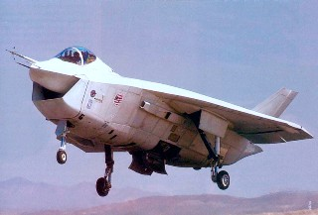
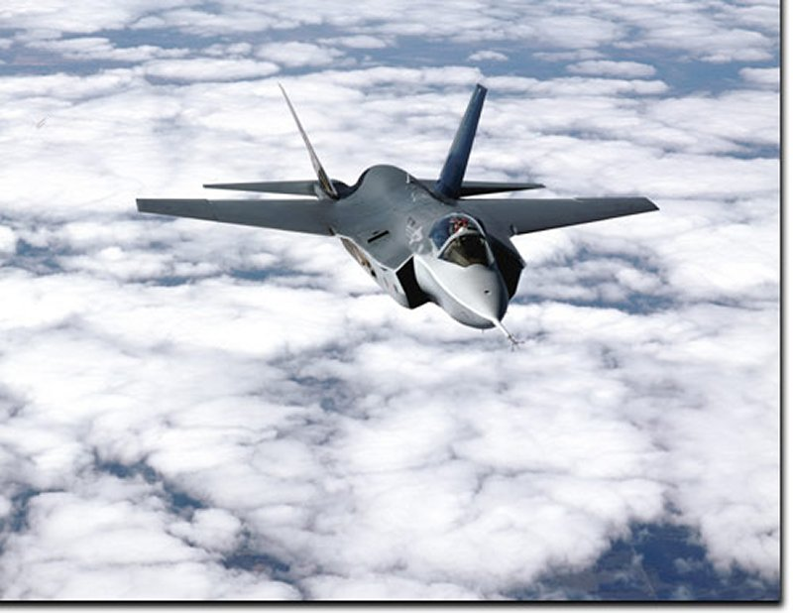
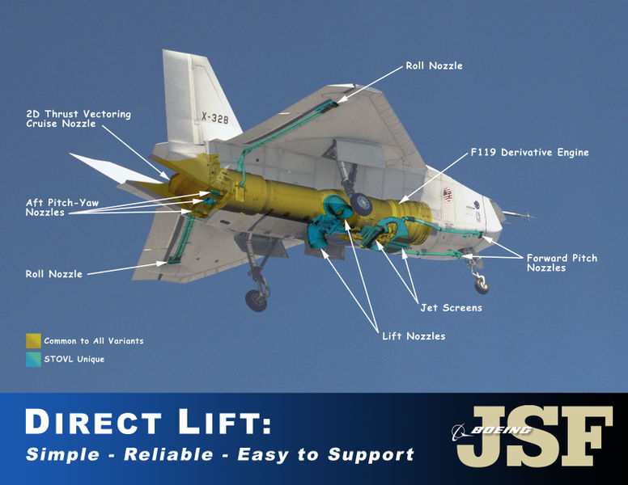
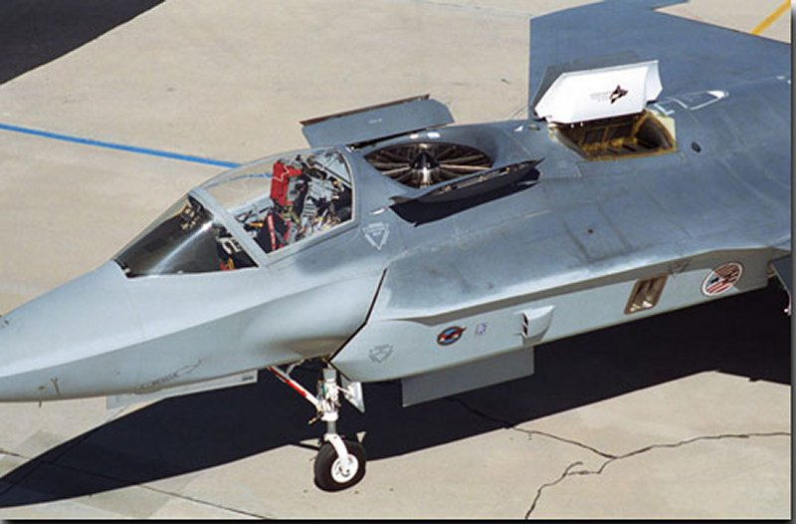
Joint Strike Fighter
Lift
fan
Direct
lift
nozzles
Boeing X-32
Process Versus Art ?
Lockheed Martin X-35
Notes:
The competition for the joint strike fighter is an amazing example of process versus art. Two contractors were given a fixed amount of money to produce prototypes that met demanding requirements for flight demonstrations. The two companies took dramatically different approaches based on a different view of the art and process required to engineer such a complex system. The next chart explains it further. WGBH produced an excellent documentary on this effort called “Battle of the X Planes” as part fo their NOVA series and I highly recommend it for viewing. This was a huge competition with future contracts worth billions of dollars. It may be the last true human piloted fighter ever built. It meant life or death for both of these companies’ fighter aircraft divisions. They both pulled out all the stops to win it. It is therefore very interesting to see the differences in approaches given the stakes.

Slide 7
X-32 versus X-35
Competition for the Joint Strike Fighter may represent a case study in process versus art
As best I can piece together, both designs met all the requirements and were well engineered
  X-32 was optimized to meet all the requirements with the specified margins – did not have additional potential –
    Total execution of process to deliver the minimum cost and minimum risk vehicle to meet the requirements
    Direct lift was not the most efficient propulsion technique but it was low cost/ low risk because it was used in a previous product – The Harrier
    Design led in some ways to a non-traditional “look” for a fighter
  X-35 had significant additional growth capability over the required margin but it required use of a new high risk technology (lift fan)
    To some, X-35 was a more appealing mold line (outer shape) and represented more of a fighter configuration
In the end, the DOD selected X-35
  I don’t know if there were other overriding factors , but I would argue that it may have been a victory of art over process
  Lockheed went beyond the requirements and found a design that met the requirements but included capability beyond the requirements
  Lockheed understood that the requirements were a minimum and that the vehicle had to look like a fighter and be prepared to dela with future unknowns

Slide 8

How do we teach art ?
Elements of style
Reviewing the work of masters
Lots of practice and critique on smaller scale projects
  Learn to develop techniques on small scale before going to larger scale
Remember this from high school ?
Notes:
Elements of style is a book that was widely used in the 50’s-80’s to teach composition or writing style in high schools.

Slide 9
Seven Elements of Style in Systems Engineering
Robustness
Elegance
Balance
Growth Capability
Visibility
Reasonableness
Complexity

Slide 10
Robustness
Sensitivity to the boundary conditions
Does the system gracefully degrade or is there nonlinear behavior at the boundary conditions
  Sensitivity analysis
  Awareness of non-linear relationships
Characteristics that contribute to robustness
  Margin
  Fault tolerance
We can teach robust design techniques
More robust
Less robust
Cost
function
Cost
function
Operating
condition
Operating
condition

Slide 11
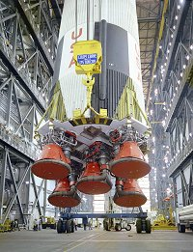
Saturn V
Original Saturn V first and second stage designs met all known requirements with four engines
Von Braun’s team at Marshall Space Flight Center added a fifth engine to first and second stage for margin
  Fifth engine added in center – minimum impact as it did not have to be gimballed (swiveled) for steering
Apollo would not have been possible if that performance had not been available as mass in the command/service module and lunar module grew
  Additional performance also enabled more science content in the later Apollo J missions
Very similar to Lockheed Martin’s decision to use lift-fan on X-35
  You’ve got to know when you need to make the design more robust

Slide 12
Robustness doesn’t have to cost weight, or large money investment
The X-38 lifting body control system design was completely computer controlled – fly by wire
As initially designed, the zero voltage output from the aero surface command electronics resulted in the body flaps all the way down and the highest output voltage resulted in them all the way up.
We discovered that if the electronics lost power, that they would fail to a zero output
During the design, we asked what if we set up the actuator electronics so that the aero surface position for trim flight would result when receiving a zero output from the electronics
  Needed to put some resistors in the interface between the command channel and the actuator
  This would minimize the disturbing forces from a surface if the command electronics lost power
In simulation, we found that the vehicle could fly on one body flap if the other was in trim. It could not if the flap was ll the way hard down
We then channelized the left and right body flaps into different command electronics channels – we had to have two channels anyway because we had four surfaces and could only put two surfaces in each command channel electronics
We discovered that we could do the same thing with the rudders
Result was that a single string flight control system could withstand failure of any one of it’s command electronics channels and still maintain stable flight
  Single fault tolerance out of a non-redundant system !
Notes:
This is an interesting case in technical leadership. Originally there were no requirements for fault tolerance on the atmospheric test vehicles of the X-38. But in designing the control system, we found a way to add robustness into the system at very low cost. Later, when we were dealing with safety reviews, this robustness was critical in getting approval to fly the vehicle by dropping it from NASA’s B-52 bomber. A process focus would have said “robustness not required – no requirement” – the art or technical leadership said “but if its low cost and we can add robustness, we should do it”.

Slide 13
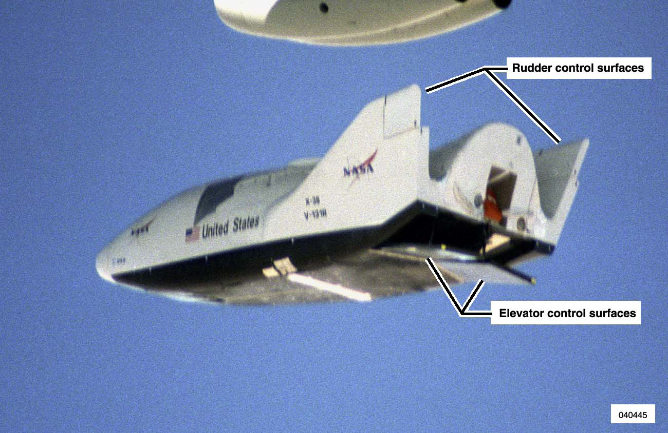
X-38 controls
Notes:
The X-38 lifting body was a prototype ambulance/lifeboat for the space station. It used a lifting body to fly through the atmosphere. Lifting bodies are notoriously hard to control because instead of using wings and control surfaces on the wings, all the lift comes from the body moving through the air and the controls have a short moment arm because they are so close to the center of gravity which reduces their effectiveness. The X-38 was modeled after the previous X-24 lifting body and used two body flaps or elevators) for pitch and roll control and two rudders for yaw and roll control. They were driven by electrical actuators that were so powerful that you could have stacked three two ton trucks fully loaded on the end of the surface and given the command to move and the surface would have moved its entire travel in less than a second, lifting the three trucks. For more info on the X-38 consult wikipedia or the media archives at nasa’s dryden flight research center.

Slide 14
Ch 1
Right
Rudder
Fails hardover
Ch 2
Left
Rudder
Fails Hardover
Unit A
Ch 3
Right
Flap
Operational
Unit B
Operational
Ch 4
Left
Flap
Original System Response to Unit A Failure
Ch 1
Right
Rudder
Fails to trim
Unit A
Ch 2
Left
Flap
Fails to middle of range
Ch 3
Left
Rudder
Operational
Unit B
Ch 4
Right
Flap
Operational
Re-channelized System
Response to Unit A failure
Notes:
The top of this diagram shows the original plan to assign channels in the flight control system to surfaces. Because of electronics limitations each control unit could handle 2 surfaces. Initially it was thought that we should put both rudders on one unit and both bodyflaps (elevators) on the other unit. By changing the design so that a failed control unit issued a command to put the surfaces in trim, and then re-channelizing the unit, we gained fault tolerance, the ability to withstand any single fault, without having to add redundant units to the system.

Slide 15
Elegance
Does the design reflect simple unifying solution OR
are there a series of special solutions (kludges) which are required for special conditions within the normal operating envelope
Awareness and avoidance of singularities

Slide 16
Balance
Unbalanced designs rarely are world beaters
A balanced design is where all of the disciplines are considered and work together
  Even in balanced design, some disciplines are more important than others
The nature of discipline engineering makes it a challenge to achieve balance (see cartoon next page)
This is why it is vitally important for systems engineers to know what is important in a given design
  Not all elements of the design get the same attention or need the same amount of rigor
    In a world of limited resources it is important to “sharpen your pencil” only on the important areas of the design
  However all elements must be considered to ensure that they are working together instead of against each other

Slide 17
Growth Capability - Scalability , and Extensibility
Scalability – can the design be grown to handle larger amounts of its current function
Extensible – can the design be grown to provide additional functionality
The difficulties of delivering designs on cost and schedule results in a tendency towards closed designs which cannot be grown or extended
Techniques exists to help maintain scalability, extensibility and growth capability
  Built on standards – particularly on interfaces
  Monitoring and managing margins during development
  Having growth targets
  Hooks and scars to extend capability
    Hooks – a provision in hardware to allow future growth or additional capabilities
    Scar – a provision in software to allow future growth or additional capabilities
  Awareness of the physics based limitations
    Usually through modeling

Slide 18
Visibility
Most systems are inherently invisible
  Especially software intensive systems
Systems engineer must recognize this nature and design in visibility
  Instrumentation
  Alerts and warnings, displays and controls
  Access points for viewing system internal functioning during verification
  Models that predict system function that are verified by test

Slide 19

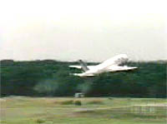
Lack of Visibility Examples
At least two Airbus crashes have been blamed on confusion between what the pilot thought the system was doing and what the system was actually doing
  In one crash, the pilot thought the aircraft was in Takeoff Go Around mode (TOGA) and the aircraft crashed
  In one crash, the pilot was attempting a landing and the system was accidentally switched to TOGA mode
Three Mile Island was also a case of system functioning being invisible to the operator
  Operators thought water level high
  In fact water level was so low that core was almost exposed
Learning how to make the system visible and building it so that its behavior is natural and instinctive for humans is a critical part of good systems engineering
Notes:
The left picture shows the Airbus crashing at the Paris air show, The right picture is a visual of the reactors and cooling towers at Three Mile Island Nuclear Power Plant.

Slide 20
Reasonableness
Technology moves ahead both in gradual evolution and rapid revolution
Evolution involves design principles and technology with good heritage
Revolution involves new design principles and technologies
When attempting both evolutionary and revolutionary progress, it is really important to apply reasonableness tests
  For evolution – can ask about design principles and heritage of technology
  For revolution – have to ask about experience in smaller scale and the theoretical-model based analysis and predictions
The history of technological progress is littered with ideas whose promise was so appealing that the analysis which showed that the idea was impractical was ignored

Slide 21
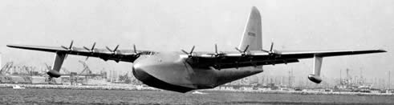
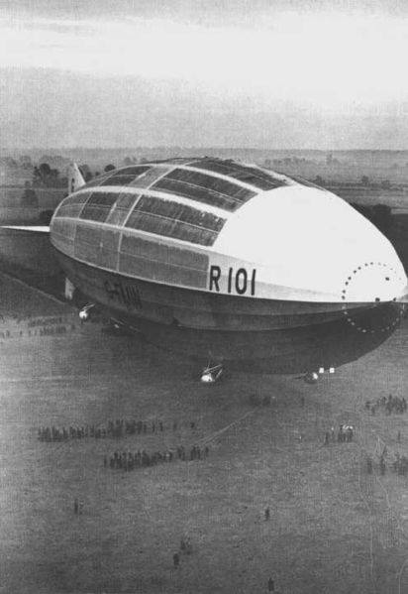
Reasonableness
The Spruce Goose
By far the biggest airplane ever built, the H-4, also known as the Hercules, had a wingspan of 320 feet--20 feet longer than a football field. It had enough cargo space to carry two railroad boxcars. It had eight massive engines with 17-foot propellers. It weighed 300,000 pounds. And it was made of wood
It only ever flew once at low altitude for about a mile….
From www.straightdope.com
R101
Crew: 45
Capacity: 100
Length: 777 ft in (237 m)
Diameter: 131 ft in (40 m)
Volume: 5.5 million ft³ (160,000 m³)
Useful lift: 100,000 lb (45,000 kg)
Powerplant: 5 × Beardmore MkI
Tornado 8 cylinder diesel 585 hp (436 kW) each
Hindenburg was eventually built larger by Germany but only
after many several smaller dirigibles. The R101 was UK’s first attempt at a dirigible

Slide 22
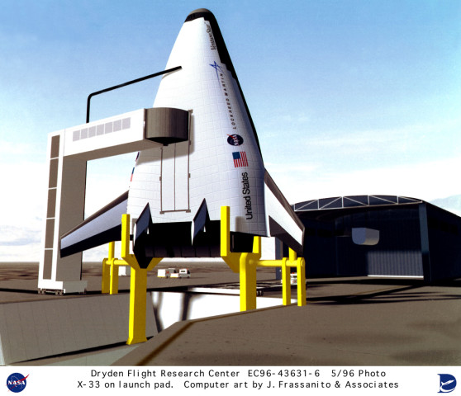
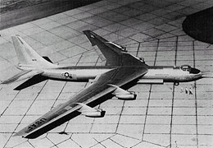
Nuclear powered airplane pursued in the 1950’s
Prototype built – idea was unending flight
Never practical – nuclear reactors are nowhere near the efficiency of aircraft power plants and the shielding weight is prohibitive
X-33
Idea was single stage to orbit
Required the structural efficiency greater than that of a soda can while subjected to thermal, aerodynamic, inertial and internal pressure loads

Slide 23
Complexity
Managing complexity is one of the key aspects of the ART of systems engineering
Understanding and avoiding overly complex solutions is critical
Establishing clean interfaces which minimize interaction between components is a critical skill
Establishing layers in defining a system is one of our best techniques

Slide 24
Reviewing the work of masters
Air Force Institute of Technology (AFIT) Center for Systems Engineering (CSE) – excellent case studies - http://www.afit.edu/cse/cases.cfm
  B-2, C-5A, F-111, GPS, Hubble Space Telescope, Peacekeeper, Theatre Battle Management System
Johnson, The Secret of Apollo, Systems Management in the American and European Space Programs
Bugos, Engineering the F-4 Phantom II, Parts into Systems
Chiles, Inviting Disaster, Lessons from the Edge of Technology
Mishap reports – NASA Office of Logic Design - http://klabs.org/reports.htm#failure_reports

Slide 25
Develop techniques on small scale projects
Artists don’t start out creating a great masterpiece in their first painting or sculpture
Why do we think that systems engineers can start out succeeding on large scale projects
  There is only so much that you can learn as an apprentice carrying the master’s paints
  Apprentice training is our major training technique when we assign systems engineers to large projects
Need to have projects where the skills and techniques can be developed
Big things can evolve out of this approach
  New Mission Control Center with > 250 computers in a distributed system grew out of a core set of software developed by a small number of young people working on 4 computers
Only requirement is that the problem contain the real issues

Slide 26
Conclusion
The ART is a key part of Systems Engineering
We can define the elements of style, masters to follow and teach how to develop techniques in the small
  This briefing is an attempt to define some of the key elements
Learning how to teach and incorporate ART is the key to improved systems engineering practice

